Slide 1
Chapter 22: Documenting an Architecture
Documentation is a love letter that you write to your future self.
—Damian Conway

Slide 2
Chapter Outline
Uses and Audiences for Architecture Documentation
Notations
Views
Combining Views
Documenting Behavior
Beyond Views
Documenting the Rationale
Architecture Stakeholders
Practical Considerations
Summary

Slide 3
Architecture Documentation
An architecture has to be communicated to let its stakeholders use it properly to do their jobs.
If you go to the trouble of creating a strong architecture, you must go to the trouble of describing it.
Documentation speaks for the architect today, when the architect should be doing other things besides answering questions, and tomorrow, when that person has left the project.

Slide 4
Architecture Documentation
Even the best architecture will be useless if the people who need it
do not know what it is;
cannot understand it well enough to use, build, or modify it;
misunderstand it and apply it incorrectly.
All of the effort, analysis, hard work, and insightful design on the part of the architecture team will have been wasted.

Slide 5
Uses and Audience for Architecture Documentation
Architecture documentation must
be sufficiently transparent and accessible to be quickly understood by new employees
be sufficiently concrete to serve as a blueprint for construction
have enough information to serve as a basis for analysis.
Architecture documentation is both prescriptive and descriptive.
For some audiences, it prescribes what should be true, placing constraints on decisions yet to be made.
For other audiences, it describes what is true, recounting decisions already made about a system’s design.
Understanding stakeholder uses of architecture documentation is essential
Those uses determine the information to capture.

Slide 6
Uses and Audiences for Architecture Documentation
Education
Introducing people to the system
New members of the team
External analysts or evaluators
New architect
Primary vehicle for communication among stakeholders
Especially architect to developers
Especially architect to future architect!
Basis for system analysis and construction
Architecture tells implementers what to implement.
Each module has interfaces that must be provided and uses interfaces from other modules.
Basis for forensics when an incident occurs.
When an incident occurs, someone is responsible for tracking down the underlying causes.
Information about the flow of control immediately prior to the incident will provide the “as executed” architecture.

Slide 7
Notations
Informal notations
Views are depicted (often graphically) using general-purpose diagramming and editing tools
The semantics of the description are characterized in natural language
They cannot be formally analyzed
Semiformal notations
Standardized notation that prescribes graphical elements and rules of construction
Lacks a complete semantic treatment of the meaning of those elements
Rudimentary analysis can be applied
UML is a semiformal notation in this sense.
Formal notations
Views are described in a notation that has a precise (usually mathematically based) semantics.
Formal analysis of both syntax and semantics is possible.
Architecture description languages (ADLs)
Support automation through associated tools.

Slide 8
Choosing a Notation
Tradeoffs
Typically, more formal notations take more time and effort to create and understand, but offer reduced ambiguity and more opportunities for analysis.
Conversely, more informal notations are easier to create, but they provide fewer guarantees.
Different notations are better (or worse) for expressing different kinds of information.
UML class diagram will not help you reason about schedulability, nor will a sequence chart tell you very much about the system’s likelihood of being delivered on time.
Choose your notations and representation languages knowing the important issues you need to capture and reason about.

Slide 9
Views
Views let us divide a software architecture into a number of (we hope) interesting and manageable representations of the system.
Principle of architecture documentation:
Documenting an architecture is a matter of documenting the relevant views and then adding documentation that applies to more than one view.

Slide 10
Which Views? The Ones You Need!
Different views support different goals and uses.
We do not advocate a particular view or collection of views.
The views you should document depend on the uses you expect to make of the documentation.
Each view has a cost and a benefit; you should ensure that the benefits of maintaining a view outweigh its costs.

Slide 11
Overview of Module Views
Elements
Modules, which are implementation units of software that provide a coherent set of responsibilities.
Relations
Is part of, which defines a part/whole relationship between the submodule—the part—and the aggregate module—the whole.
Depends on, which defines a dependency relationship between two modules. Specific module views elaborate what dependency is meant.
Is a, which defines a generalization/specialization relationship between a more specific module—the child—and a more general module—the parent.

Slide 12
Overview of Module Views
Constraints
Different module views may impose specific topological constraints, such as limitations on the visibility between modules.
Usage
Blueprint for construction of the code
Change-impact analysis
Planning incremental development
Requirements traceability analysis
Communicating the functionality of a system and the structure of its code base
Supporting the definition of work assignments, implementation schedules, and budget information
Showing the structure of information that the system needs to manage

Slide 13
Module Views
It is unlikely that the documentation of any software architecture can be complete without at least one module view.

Slide 14
Overview of C&C Views
Elements
Components. Principal processing units and data stores. A component has a set of ports through which it interacts with other components (via connectors).
Connectors. Pathways of interaction between components. Connectors have a set of roles (interfaces) that indicate how components may use a connector in interactions.
Relations
Attachments. Component ports are associated with connector roles to yield a graph of components and connectors.
Interface delegation. In some situations component ports are associated with one or more ports in an “internal” subarchitecture. The case is similar for the roles of a connector

Slide 15
Overview of C&C Views
Constraints
Components can only be attached to connectors, not directly to other components.
Connectors can only be attached to components, not directly to other connectors.
Attachments can only be made between compatible ports and roles.
Interface delegation can only be defined between two compatible ports (or two compatible roles).
Connectors cannot appear in isolation; a connector must be attached to a component.
Usage
Show how the system works.
Guide development by specifying structure and behavior of runtime elements.
Help reason about runtime system quality attributes, such as performance and availability.

Slide 16
Notations for C&C Views
UML components are good match for C&C components.

Slide 17
Overview of Allocation Views
Elements
Software element and environmental element.
A software element has properties that are required of the environment.
An environmental element has properties that are provided to the software.
Relations
Allocated to. A software element is mapped (allocated to) an environmental element. Properties are dependent on the particular view.

Slide 18
Overview of Allocation Views
Constraints
Varies by view
Usage
Reasoning about performance, availability, security, and safety.
Reasoning about distributed development and allocation of work to teams.
Reasoning about concurrent access to software versions.
Reasoning about the form and mechanisms of system installation.

Slide 19
Quality Views
A quality view can be tailored for specific stakeholders or to address specific concerns.
A quality views is formed by extracting the relevant pieces of structural views and packaging them together.

Slide 20
Quality Views: Examples
Security view
Show the components that have some security role or responsibility, how those components communicate, any data repositories for security information, and repositories that are of security interest.
The view’s context information would show other security measures (such as physical security) in the system’s environment.
The behavior part of a security view
Show how the operation of security protocols and where and how humans interact with the security elements.
Capture how the system would respond to specific threats and vulnerabilities.
Communications view
Especially helpful for systems that are globally dispersed and heterogeneous.
Show all of the component-to-component channels, the various network channels, quality-of-service parameter values, and areas of concurrency.
Used to analyze certain kinds of performance and reliability (such as deadlock or race condition detection).
The behavior part of this view could show (for example) how network bandwidth is dynamically allocated.

Slide 21
Quality Views: Examples
Exception or error-handling view
Could help illuminate and draw attention to error reporting and resolution mechanisms.
Show how components detect, report, and resolve faults or errors.
It would help identify the sources of errors and appropriate corrective actions for each.
Reliability view
Models mechanisms such as replication and switchover.
Depicts timing issues and transaction integrity.
Performance view
Shows those aspects of the architecture useful for inferring the system’s performance.
Show network traffic models, maximum latencies for operations, and so forth.

Slide 22
Choosing the Views
At a minimum, expect to have at least one module view, at least one C&C view, and for larger systems, at least one allocation view in your architecture document.

Slide 23
Combining Views
Sometimes it is convenient to show a combined view with elements and relations that come from two or more other views.
Such views can be very useful as long as you do not try to overload them.

Slide 24
Combining Views
The following combinations of views often occur quite naturally:
C&C views with each other
Deployment view with any C&C view that shows processes
Decomposition view and any work assignment, implementation, uses, or layered views

Slide 25
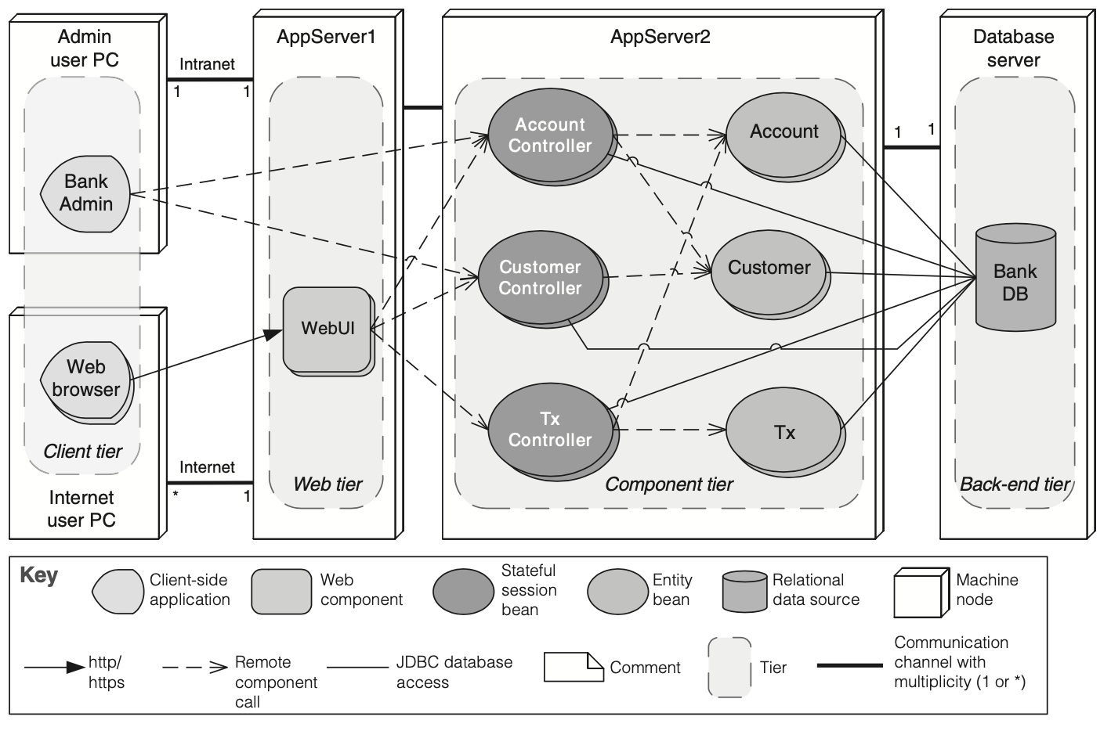
Combining Views
A combined view (example)

Slide 26
Documenting Behavior
An architecture may require behavior documentation describing how elements interact with each other.
Two kinds of notations are available for documenting behavior: trace-oriented and comprehensive.

Slide 27
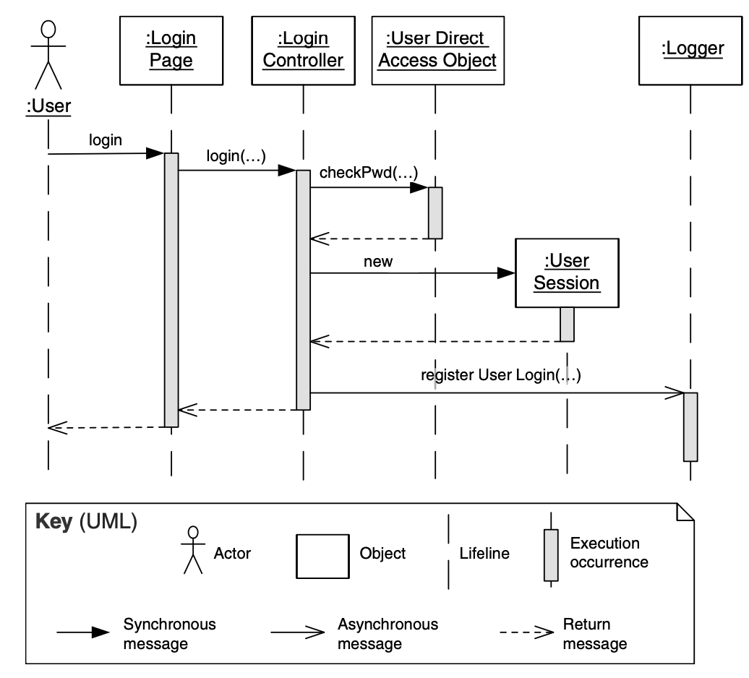
Documenting Behavior
Traces are sequences of activities or interactions that describe the system’s response to a specific stimulus when the system is in a specific state.
UML Examples:
use case diagrams
sequence diagrams
communication diagrams
activity diagrams.

Slide 28
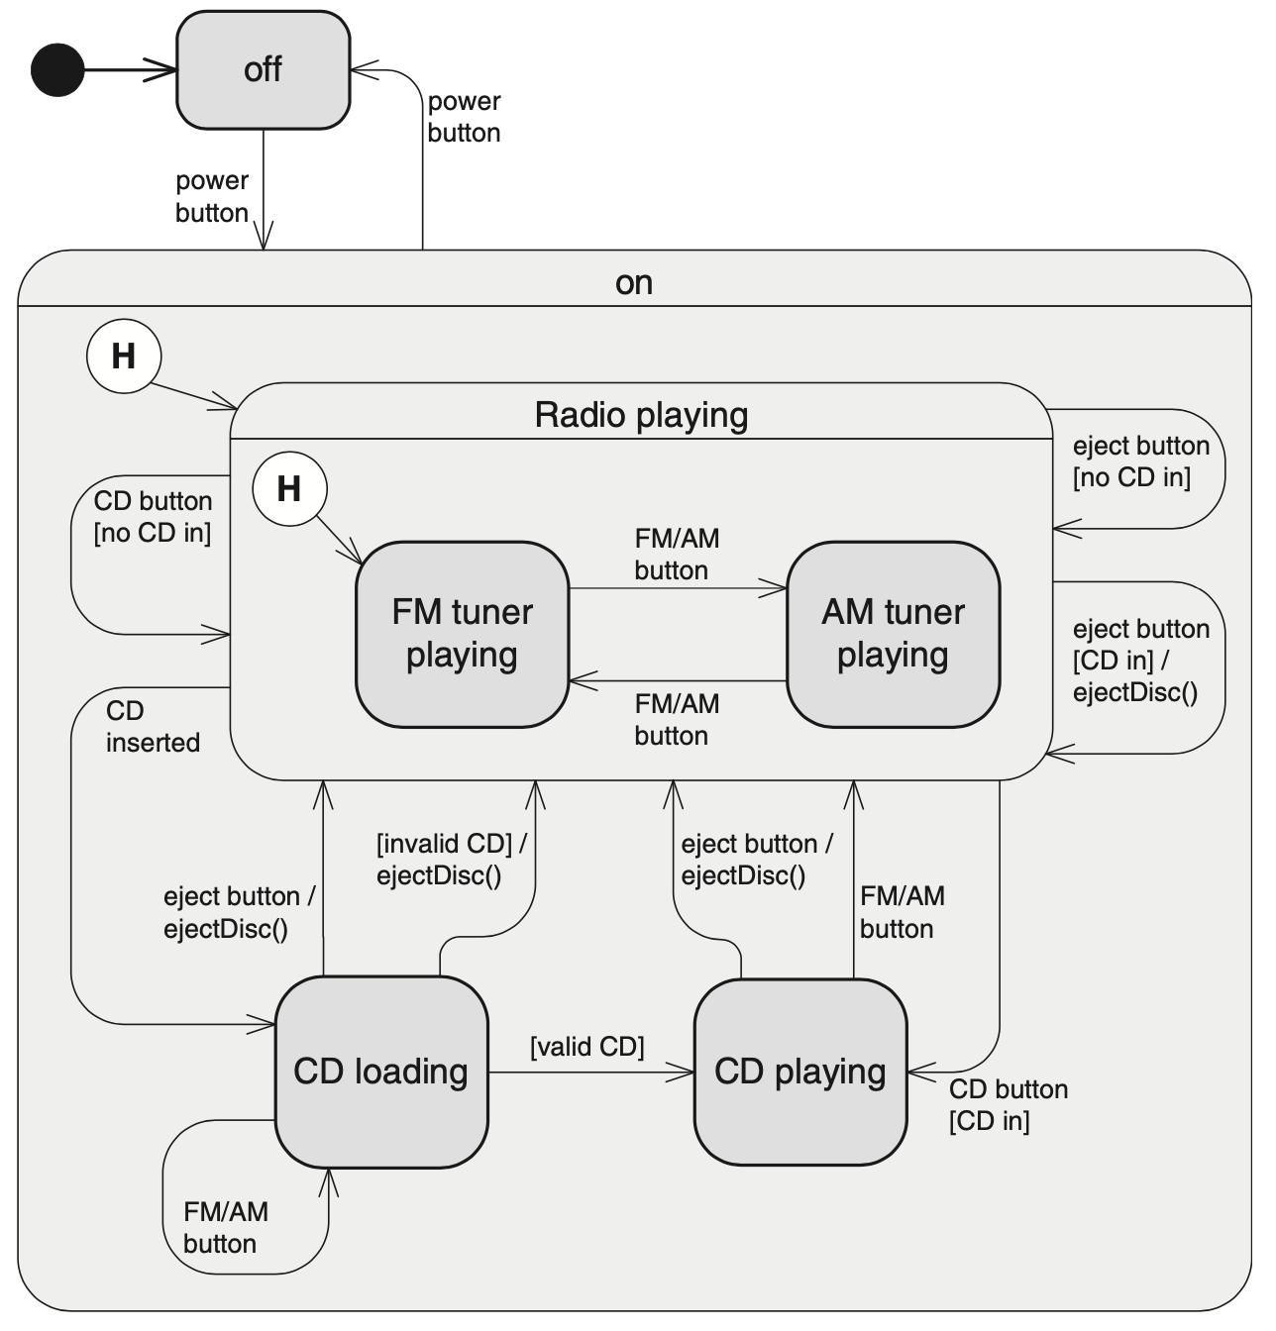
Documenting Behavior
Comprehensive notations show the complete behavior of structural elements. Given such documentation, it is possible to infer all possible paths through the system.
UML Example:
state machine diagrams

Slide 29
Building a Documentation Package
A documentation package consists of
Views
Documentation beyond views

Slide 30
Beyond Views
In addition to views and behavior, comprehensive information about an architecture will include the following items:
Mapping between views
Documenting patterns
One or more context diagrams
Variability guide
Rationale
Glossary and acronym list
Document control information

Slide 31
Documenting Rationale
When designing, you make decisions to achieve your iteration goals. These decisions include:
Selecting a design concept from several alternatives
Creating structures by instantiating the selected design concept
Establishing relationships between elements and defining interfaces
Allocating resources (e.g., people, hardware, computation)
When you study an architecture diagram, you only see the end product of a thought process.

Slide 32
Documenting Rationale
Recording design decisions beyond the chosen elements, relationships, and properties is fundamental to help understand how you arrived at the result—the design rationale.
For example, you might record:
What evidence was produced to justify decisions?
Who did what?
Why were shortcuts taken?
Why were tradeoffs made?
What assumptions did you make?

Slide 33
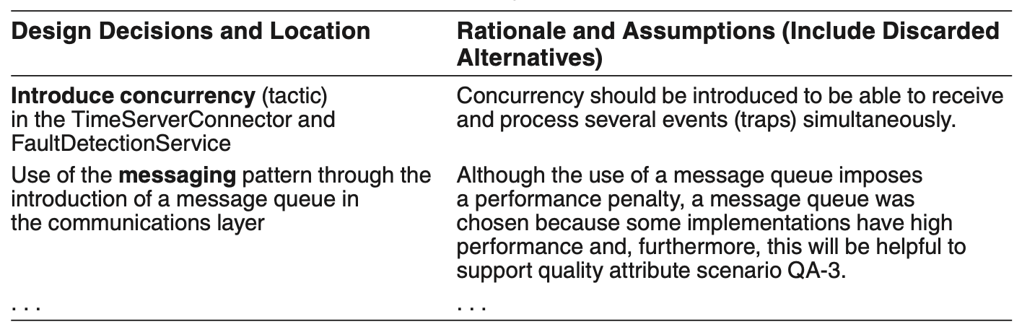
Documenting Rationale
Example:

Slide 34
Architecture Stakeholders
Key stakeholders of an architecture, and the views that care about include:
Project managers:
care about schedule, resource assignments, etc.
To create a schedule, they need information about the modules to be implemented and in what sequence, with information about their complexity, such as the list of responsibilities, and dependencies on other modules

Slide 35
Architecture Stakeholders
Members of the development team:
will want to know the general idea behind the system.
which elements they have been assigned for implementation.
the details of the assigned element, including the data model with which it must operate.
the elements with which the assigned part interfaces and what those interfaces are.
the code assets that the developer can utilize.
the constraints, such as quality attributes, legacy system interfaces, and budgets that must be met.

Slide 36
Architecture Stakeholders
Testers and integrators:
a black-box tester will need to access the interface documentation for the element.
integrators and system testers need to see collections of interfaces, behavior specifications, and a uses view so they can work with incremental subsets.
Maintainers:
will want to see a decomposition view that allows them to pinpoint the locations where a change will need to be carried out, and perhaps a uses view to help them build an impact analysis to fully scope out the effects of the change.
in addition, they will want to see the design rationale.

Slide 37
Architecture Stakeholders
Designers of other systems:
these stakeholders will want to see interface documentation for elements their system will interact with, as found in module and C&C views
the data model for the system they will interact with
top-level context diagrams from various views showing the interactions
End users:
can often gain useful insights into the system, what it does, and how they can use it effectively by examining the architecture.

Slide 38
Architecture Stakeholders
Analysts:
are interested in whether the design meets the system’s quality objectives.
they require architectural information necessary to evaluate quality attributes.
Infrastructure support personnel:
set up the infrastructure that supports the development, integration, staging, and production environments.
a variability guide is particularly useful to help set up the software configuration management environment.
Future architects:
are the most avid readers of architecture documentation, with a vested interest in everything.

Slide 39
Practical Considerations
Modeling tools:
Tools offer features aimed at large-scale use in industrial settings:
interfaces that support multiple users
version control
syntactic and semantic consistency checking of the models
traceability between models and requirements or models and tests
automatic generation of executable source code that implements the models.

Slide 40
Practical Considerations
Online documentation, hypertext, and wikis:
Documentation for a system can be structured as linked web pages.
Using tools such as wikis, it’s possible to create a shared document to which many stakeholders can contribute.

Slide 41
Practical Considerations
Release strategy:
Your project’s development plan should specify the process for keeping the important documentation, including the architecture documentation, current.
Document artifacts should be subject to version control, as with any other important project artifact.
The architect should plan releases of the documentation to support major project milestones.

Slide 42
Practical Considerations
Documenting architectures that change dynamically.
If your architecture changes rapidly (at runtime, or as a result of frequent releases):
Document what is true about all versions of your system.
Document the ways the architecture is allowed to change.
Generate interface documentation automatically.

Slide 43
Practical Considerations
Traceability:
Traceability means linking design decisions to the requirements that led to them; those links should be captured in the documentation.
We seek to account for all ASRs in the architecture’s trace links.
Trace links may be represented informally—a table, for instance—or may be supported technologically in the project’s tool environment.

Slide 44
Summary
Architectural documentation supports communication among various stakeholders, up the management chain, down to the developers, and across to peers.
You must understand the uses to which the documentation is to be put and its audience.
An architecture is a complicated artifact, best expressed by focusing on views.
You must choose the views to document, the notations, and a set of views that is both minimal and adequate.
There are other practical considerations, such as choosing a release strategy, choosing a dissemination tool, and creating documentation for architectures that change dynamically.

